Slide 1
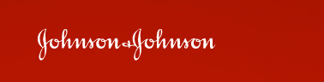




Aras Overview
February 2009

Slide 2

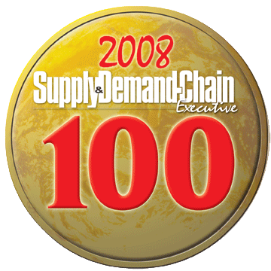

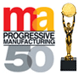


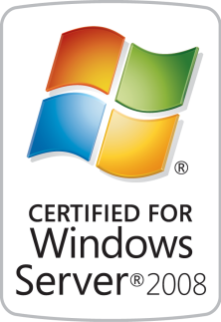
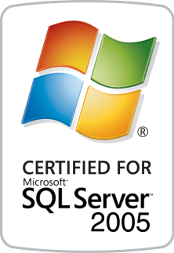
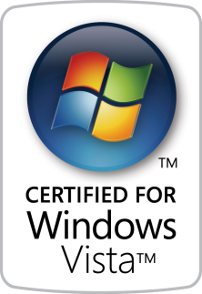
Aras Overview
Business: Enterprise Open Source PLM ►NPDI New Product Development & Introduction ►R&D Research & Development ►CM Configuration & Change Management ►DM Document Management ►APQP Advanced Product Quality Planning ►CAPA Corrective & Preventive Actions ►FMEA Risk Management ►BPM Business Process Management
Technology: Advanced Model-based Enterprise SOA
Certifications: Only Microsoft Certified Enterprise PLM

Slide 3
PLM Issues
Islands of data without end-to-end process management
Licensing model is wrong for the enterprise
Too expensive to achieve enterprise-wide collaboration
Lots of people need access in addition to R&D
Brand Mgt, Quality, Operations, Sourcing, Suppliers
Executives lack Visibility
No product intelligence for business decisions
Systems are too difficult to use

Slide 4

Microsoft Enterprise Open Source PLM
Cost effective way to collaborate across enterprise
Solution delivers:
Comprehensive PLM capabilities and functionality
Cross-functional business processes
More than just browse capabilities
Extended enterprise collaboration
Searching and viewing of product information
Executive visibility & product intelligence
Secure, easy-to-use, easy to deploy & support

Slide 5






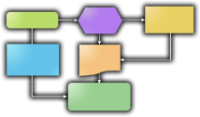



Enterprise PLM Processes
Concept
R&D
Development
Launch
Manufacture
Channel
NPDI Phase-Gate Product Management
ERP & Custom Systems
Recipe Mgt
Packaging CAD
Document Mgt
File Vault
Change Mgt
“The Void”
No Visibility, Info Islands
No Repeatable Processes
Not Lean
Legacy Systems
Ideation Process
Requirements
&
Specifications
BOMs & Parts
AVL / AML
Qualified
Suppliers
Supplier
Collaboration
Reports &
Dashboards
FMEA
Process Flows
Control
Plans
CAPA
Corrective Actions

Slide 6











Enterprise PLM Architecture
Browser
Office Integration
Reporting
Dashboards
Business Logic
Outlook
Word
Excel
SharePoint
Microsoft
Reporting
Services
Web Parts
.NET UI Components
Innovator Object Model
Client Side
.NET Web Services
Server Side
Business Logic
SOA
XML/SOAP
Business Objects & Processes
Web Services
Meta Data Management
Lifecycle Services
Workflow Services
Configuration Services
Classification Services
Search Services
Event Services
Security Services
Vaulting Services
Federation Services
Data Access Components
.NET Integrations
ADO
ODBC
Flat File
Direct API
O-R Mapping
Transaction Mgt
Cache
ADO.NET Data Access
ENOVIA MatrixOne
Other Systems
Custom & Legacy
Business Logic
Web Services
Business Objects & Processes
ESB or EAI
Object Definitions
File Vault
Process Definitions
System Definition

Slide 7



Microsoft Enterprise Open Source
Production Ready Software
Complete Solution Access
Unlimited Users
INCLUDED
Freedom from Software Licensing
Delivers Control & Flexibility
Enterprise Class Support
BENEFITS

Slide 8



































Aras Customers
New Era Ohio, LLC

Slide 9
Next Steps
Solution Demonstration
Download
Deep Dive Webinar
Proof of Concept Pilot

